Slide 1
ANDROID PIN CRACKING
Presented by:
Nidheesh Panchal (2016UCP1008)
Siddhant Gupta (2016UCP1455)
Rahul Jangir (2016UCP1396)
Guided by:
Dr. Vijay Laxmi

Slide 2
Abstract
Numeric PINs of a smartphone to be predicted by an attacker using motion data.
Zero-permission motion sensors play crucial role in exploiting this vulnerability.
Website opened in a browser or an application in background can collect data.
The pattern of each key press is observed and a suitable model is trained to identify individual digits.

Slide 3
Why Android?
Two major smartphone operating systems are Android and iOS.
Market share of Android and iOS is 81.7% and 17.9%, respectively.
Targeting Android devices means covering larger portion of all smartphones.

Slide 4
Types of Android Sensors
Motion Sensors
Accelerometer Sensor
Gyroscope Sensor
Gravity Sensor
Environmental Sensors
Position Sensors
These sensors are used for various activities like auto screen rotation, step counter etc.

Slide 5
Zero-permission Sensors
Range of zero-permission sensors are found in modern smartphones to enhance user experience. e.g. – Proximity, Gyroscope, Accelerometer sensor
These pool of sensors may unintentionally leak sensitive information.
These sensors are accessible without user permissions, so an attacker can take advantage of an unaware user.
Sensors can reveal privacy-related information about the user, such as personal identification number (PIN) or movement patterns.

Slide 6
Basic Theory
User enters PIN on numerical keypad where each possible number is in the range of (0-9).
While entering the numbers, user moves fingers to reach the number.
Smartphone will tilt, rotate or move.
These movements are minute but could be easily captured by motion sensors.
Type of sensors that captures such motion are Motion Sensors (Accelerometer, Gyroscope and Gravity).

Slide 7
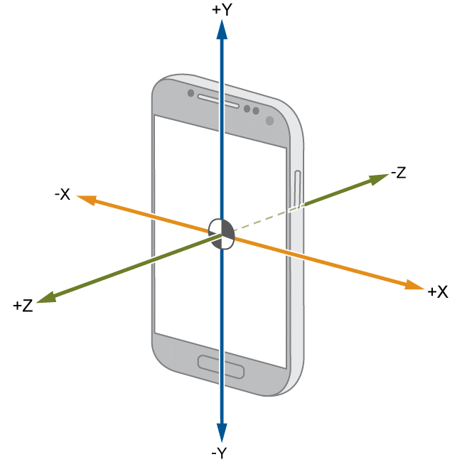
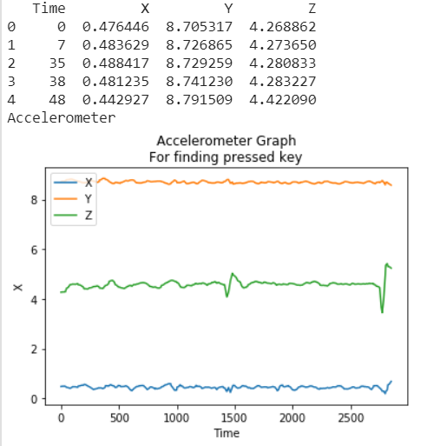
Accelerometer Sensor
Description:
Measures the acceleration force in m/s² that is applied to a device on all three physical axes (x, y, and z), may or may not include the force of gravity.
Uses:
Linear motion detection (shake, tilt)

Slide 8
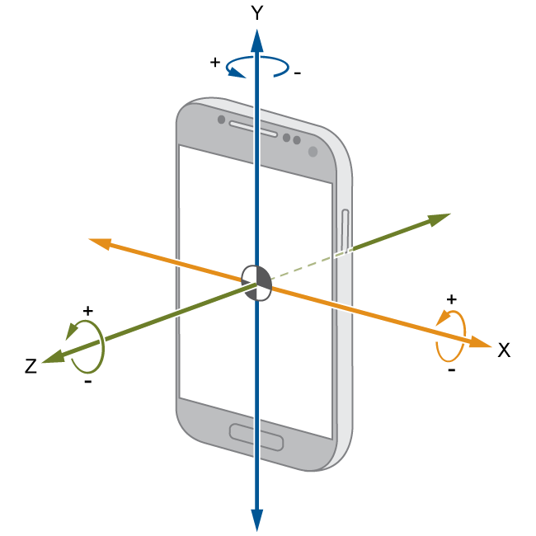
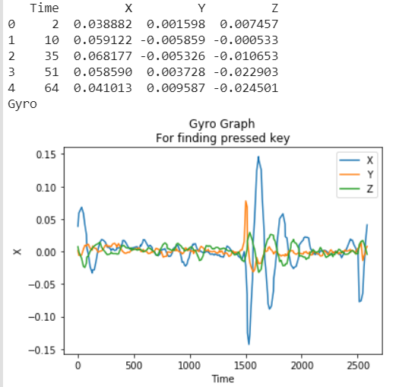
Gyroscope Sensor
Description:
Measures a device's rate of rotation in rad/s around each of the three physical axes (x, y, and z).
Uses:
Rotation detection (spin, turn).

Slide 9
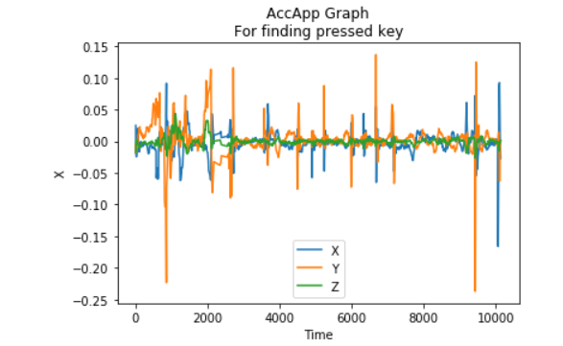
Gyroscope Sensor
We can see different patterns when different keys are pressed.

Slide 10
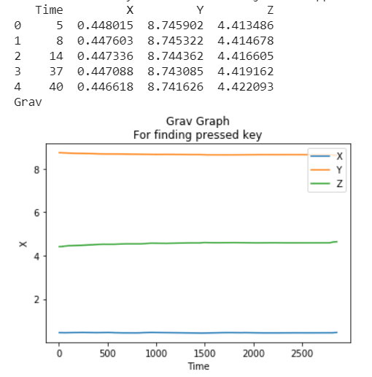
Gravitation Sensor
Description:
Measures the force of gravity in m/s² that is applied to a device on all three physical axes (x, y, z).
Uses:
Motion detection (shake, tilt).

Slide 11
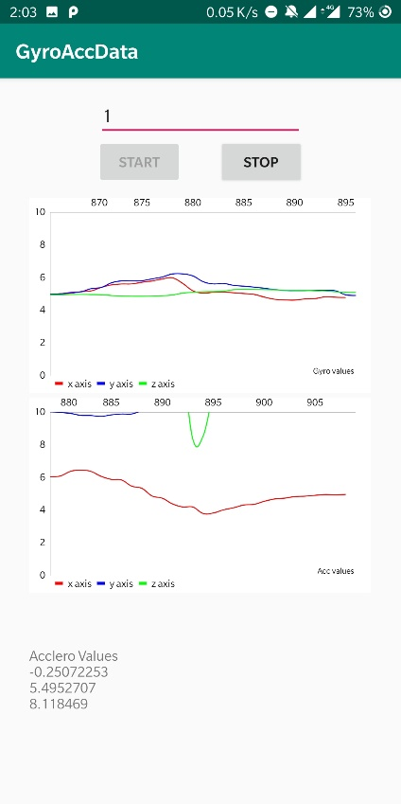
Behaviour of Sensors
Sudden spike is seen in the graph when the screen is touched.
The top graph shows the gyroscope and bottom graph shows accelerometer sensor data plotted against time.
Red: x-coordinate
Blue: y-coordinate
Green: z-coordinate

Slide 12
Proposed Method
After observing the results from the experiments performed, we propose a method to identify individual digits of a PIN.
Using an application for data collection.
Processing raw data and as input to Machine Learning model to predict individual digits.

Slide 13
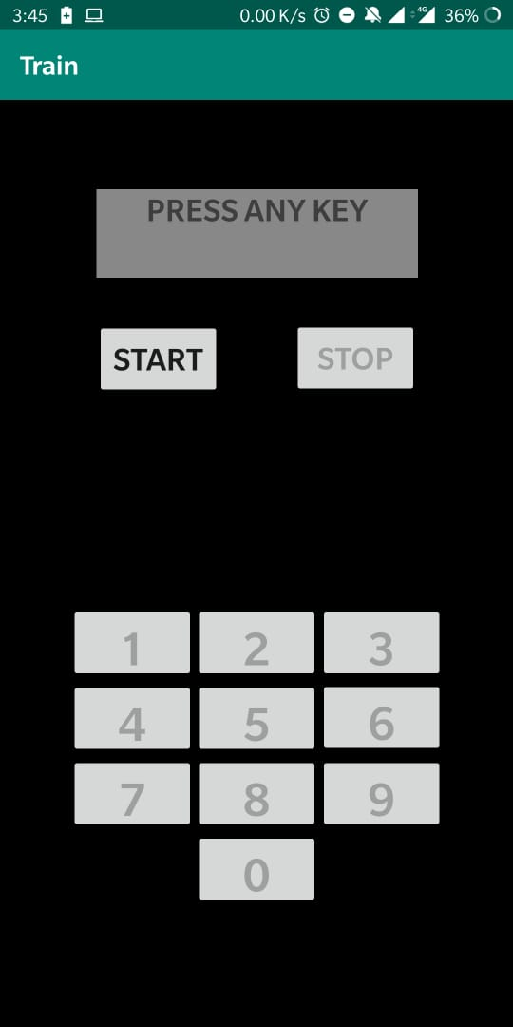
Android Application
An Android application was built to collect motion sensor data for model training.
Application named as Train.
Android application was chosen over web browser because sampling rates available in browsers are much lower than those in mobile application.
Buttons arranged at similar position as a phone PIN keyboard.

Slide 14
Data collection
Starting with a basic data collection method from a single user. Using the android application “Train”.
A user is made to either sit or stand and hold the phone in right hand in one identical position and use only right thumb (in-hand data).
Putting the phone on a flat stationary surface (on-table data).
A single file is created for each key press.
Random keys are pressed.
The app collects 4 types of sensor data
Accelerometer with gravity
Accelerometer without gravity
Gyroscope
Gravity

Slide 15
Preprocessing
The raw data collected from the application contains multiple rows of X, Y, Z coordinate values and time.
The timestamp of onKeyDown and onKeyUp actions and the number key that was pressed was saved in file name.
Three ways of data processing were used and accuracies obtained from different classification models were compared. (window of 25 and 30 values).
Windowing
Three values
Three values from uniform data.

Slide 16
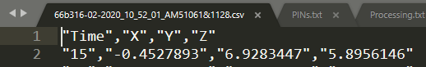

Preprocessing

Slide 17
Classification models
Following models were used for classification.
Random Forest
Decision Tree
Logistic Regression
Naïve Bayes
KNN
SVM
Multioutput
Taking all types of pre-processed dataset and taking that as input to all models running in same configuration for each (to do justice to the comparison).

Slide 18
Experimental Results
It was observed that motion detected by the gravity sensor did not show remarkable changes in sensor data values, hence did not contribute to give accurate prediction. (16%).
The following table shows maximum accuracy among all 3 types of processing methods. On-table data = 400 key press. In-hand data = 400 key press.
The processed input file are from accelerometer and gyroscope. (individually)
Processed file is split in 80:20 for train and test data.

Slide 19
Multioutput Classification Results
In multioutput classification, 4 outputs are obtained and the accuracy is calculated as:
number of times the actual key pressed label is present in this list of 4 outputs/size of test data
“List of 4” column in the following table, displays this accuracy measurement and “First 2” column displays accuracy of the actual key press present in the first 2 position from the list of 4.
The following table shows maximum accuracy among all 3 types of processing methods.
 | Multioutput
Type of data | Acc (%) |  | Gyro (%)
 | First 2 | List of 4 | First 2 | List of 4
On-table | 41 | 62 | 44 | 61
In-hand | 49.64 | 72.34 | 59.57 | 73.75
Hybrid | 43.56 | 61.82 | 51.45 | 67.63

Slide 20
Different data collection method
Observing that this basic data collection method showed potential that these accuracies can be improved.
We collected 2700 files from the user in similar method in such a way that each digit (0-9) appear after each other.
These allowed to record motion that mimics the actual motion moving from one key to other.

Slide 21
Different processing methods
Observing that the window of key press can be maximum up to 100ms, we extend the window size to accommodate all relevant data of the path.
Discarding the gravity sensor data as it did not give remarkable spike on key press.
Using individually all other 3 types of sensor data and combining each accelerometer type with gyroscope
Processing methods are as follows:
Window of 200 and 400
Uniform time (every millisecond) then take window (200, 400)
Uniform time (every millisecond), remove initial values and take window (200, 400)
The window of onkey up and onkeydown is positioned in 2 ways:
Center
At the end

Slide 22
Experimental Results
The following table shows maximum accuracy among all types of processing methods.
It was observed that combining the Accelerometer and Gyroscope sensor data gave better accuracies compared to individual processed data.
 |  | First Guess(%) | Second Guess(%) | Window (rows)
 |  |  |  | Acc | Gyro
Logistics |  | 64.29 | 84.09 | 200 | 200
SVM |  | 58.55 | 80.82 | 400 | 400
Multilayer Perceptron | 500 Iterations, Activ. Func. - Identity | 62.81 | 85.9 | 200 | 400
 | 500 Iterations, Activ. Func. - Logistics | 63.15 | 84.38 | 200 | 400
 | 1500 Iterations | 66.71 | 87.09 | 200 | 200
Processed file is split in 75:25 for train and test data.

Slide 23
Deep Learning Results
The deep Learning Model implemented from scratch, with 5 layers each of dimensions [ number of features of x , 20 , 7 , 5 , 1] gives accuracy of 18%.
The deep Learning model is Then implemented with keras, with tensorflow backend.
We are using mini batch gradient descent, k fold cross validation with shuffling of data, Adam optimizer, Activation functions used in hidden layers = relu and in outer layers = softmax.
With nodes in first layer = 4, number of iterations = 200, batch size = 10 , splits of data = 90:10 The maximum accuracy is 40.31(hybrid data), while accuracy decreased for In hand data to 35.75.
While without using any hidden layer(similar to logistic regression) The accuracy In hand data is 40.4, and hybrid data is 27.385.

Slide 24
Deep Learning Results
Increasing The nodes in Hidden units to 8 Increase The accuracy of in hand data to 40.12 and decreasing the accuracy of hybrid data to 35.49.
Increasing The nodes in Hidden units to 8 and decreasing the mini batch size to 5 Increase The accuracy of in hand data to 39.57 and decreasing the accuracy of hybrid data to 34.96.
Increasing number of epochs with nodes in one hidden unit = 4, changes accuracy slightly, for hybrid it is 40.46 , and in hand data 36.12.

Slide 25
Deep Learning Results
Deep Learning model have different hyperparameters, changing which can increase or decrease our model performance.
Here we are using Adam’s optimizer function, relu activation function in hidden Layers and softmax activation function in output layer. We are using k fold cross validation with shuffling. And mini batch gradient descent.
When number of nodes in hidden layers = 4, mini batch size = 10 , number of iterations = 200 , and splitting the data set into 90:10 the max accuracy is 67.47.
When number of nodes in hidden layers = 8, mini batch size = 10 , number of iterations = 200 , and splitting the data set into 90:10 the max accuracy is 65.27.
When number of nodes in hidden layers = 8, mini batch size = 10 , number of iterations = 200 , and splitting the data set into 80:20 the max accuracy is 62.69.
When number of nodes in hidden layers = 4, mini batch size = 10 , number of iterations = 400 , and splitting the data set into 90:10 the max accuracy is 65.65.

Slide 26
Deep Learning Results
When number of nodes in hidden layers = 3, mini batch size = 10 , number of iterations = 200 , and splitting the data set into 90:10 the max accuracy is 67.
So, here we can see that increasing iterations from 200 to 400 decreases the accuracy
Of the model. The best splitting of data is 90:10. Number of nodes in first hidden layers when increased or decreased decreases the maximum accuracy, so we choose 4 as default node in our model.

Slide 27
Conclusion
Exploring the sensors used on smartphones and exploiting the vulnerability, it is possible to develop a single-digit classification methodology to recover PIN from maliciously captured sensor data.
Using different types of preprocessing methods and different classification models to classify a single digit, the maximum accuracy achieved for on-hand data collection method is 42.5% with random forest, in-hand data collection method is 42.47% with SVM and merged data is 39.89% with KNN.
Using new data collection and processing methods where the accelerometer and gyroscope data are combined to form input, maximum accuracy observed is 66.71% in Multilayer Perceptron model with activation function as identity and maximum iterations equal to 1500.
The deep learning model results show potential of improvement and will be worked on.
The next steps include, using any different possible classification model or training method or parameters and then selecting the best out of the lot. Training the model with the collected data and creating either an Android background app service to exploit sensor data or host a website.

Slide 28
Individual Contribution
Nidheesh Panchal
Helped in building “GyroAccApp” Android applications.
Data processing methods
Different classification model selection and testing
Siddhant Gupta
Designed “Train” application
Data collection
Deep learning model and testing
Rahul Jangir
Built “Train” and “GyroAccApp” Android application.
Data collection

Slide 29
Thank you

